Slide 1
Data Frames in Python
Unit-4

Slide 2
Data Frame
Data frame is an object that is useful in representing data in the form of rows and columns
Data may come from an excel file(spreadsheet), a .csv file, a Python sequence like a dictionary, list or tuple
Python contains pandas which is a useful package for data analysis and manipulation
To create a dataframe, import pandas and then use its methods like: pandas.read_excel(), pandas.read_csv(), pandas.DataFrame()
Example.

Slide 3
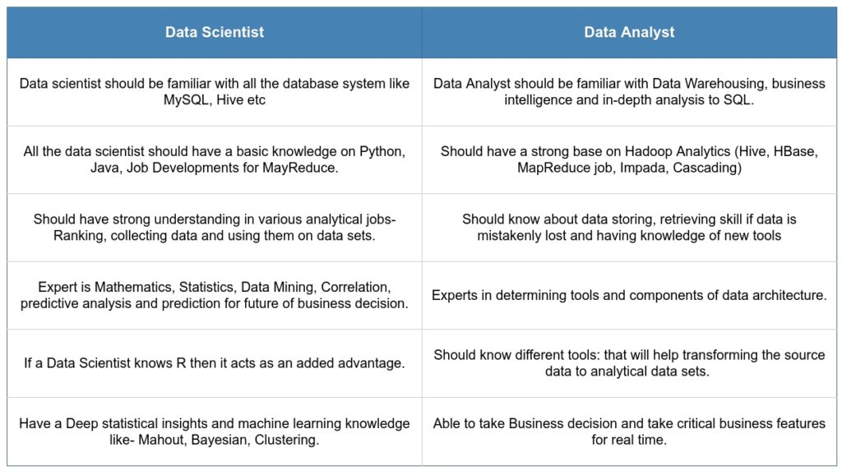

Slide 4
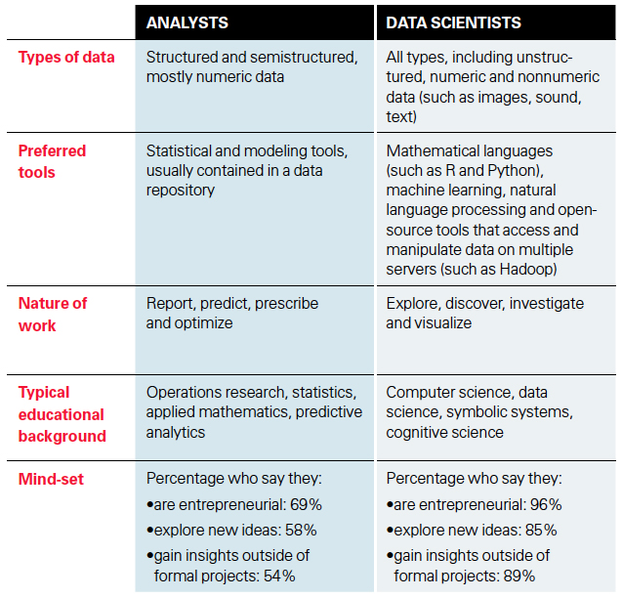

Slide 5
Operations on Data Frames
Knowing number of Rows and Columns:
df.shape -> will return a tuple of rows and columns
eg. Print(df.shape) will print (5,4) means 5 rows and 4 columns
r, c = df.shape and print(r) will just print no. of rows
Retrieving Rows from Data Frame
head() method returns 1st 5 and tail() returns last 5 rows by default
If we provide an integer parameter in it will return that many rows
Retrieving a Range of Rows
Can treat data frame as an object and rows can be retrieved using slicing
df[2:5] -> will return rows 2 to 5 (will use row id- starting from 0)
df[1::3] ->will return 1st row and 3rd row after 1st row i.e. 4th row, then 7th row and so on…
df[5:0:-1]

Slide 6
Operations on Data Frames
Retrieve Column Names:
df.columns will return list of columns with their index name.
Output: Index(['Emp ID', 'EmpName', 'Salary', 'Joining Date'], dtype='object')
Retrieve column Data
To retrieve column data, use column name as subscript
eg. print(df.EmpName) will give o/p as list of all Employee Names
2 ways: df.empid OR df[‘empid’]
Retrieving data from Multiple Columns
Provide the list of column names as a subscript to dataframe object
eg. df [[’empid’ , ’empname’]]
Finding Maximum and Minimum Values
Use max() and min() method on columns containing numerical data
eg. df [‘sal’].max()

Slide 7
Operations on Data Frames
Displaying Statistical Information
describe() method displays information like: no. of values, average, standard deviation, minimum, maximum, 25%, 50% and 75% of total value.
It is highly useful for statistical analysis. eg. df.describe()
Performing Queries on Data
We can retrieve rows based on a query
Query should be given as subscript in the data frame object
To show data from some columns based on a query, mention the list of columns and then the query
eg. 1 df[df.sal>1000]] eg2: df[[ ‘id’, ’name’]] [df.sal>1000]

Slide 8
Operations on Data Frames
Knowing the Index Range
df.index will return for eg. RangeIndex(start=0, stop=5, step=1)
Setting Column as Index
eg. df1 = df.set_index(‘empid’) OR df.set_index(‘empid’,inplace=True)
Using df.loc[1004] can access a specific row with the defined index value
Resetting the Index
df.reset_index(inplace=True)
Sorting the Data
df.sort_values(‘doj’) OR df.sort_values(‘sal’, ascending=False)
Handling Missing Data
df1 = df.fillna(0) or df1 = df.dropna()

Slide 9
Group By
df.groupby(‘aggregate column’)[‘column_name’].aggregate function()
eg.
print(df.groupby('Department')['Percentage'].mean())
print(df.groupby('Department')[['Percentage','Attendance']].mean())
result = df.groupby("Department")
.agg(Min_Marks=("Marks", "min"), Max_Attendance=("Attendance", "max"))

Slide 10
MultiIndex
A MultiIndex allows you to represent higher-dimensional data in a lower-dimensional structure (like a DataFrame).
MultiIndex in pandas allows multiple levels of indexing in rows or columns, enabling hierarchical data representation.
Eg.
Instead of:
Index → 0,1,2,3
You can have:
Index → (Year, Department)

Slide 11
Use of MultiIndex
Structured reporting of data can be done using MultiIndex
df = pd.DataFrame({
"Year": [2023, 2023, 2024, 2024],
"Dept": ["IT", "HR", "IT", "HR"],
"Marks": [80, 75, 85, 78]
})
df = df.set_index(["Year", "Dept"])
print(df)

Slide 12
Easy grouping
df.groupby(level="Year").mean()
Easy selection
df.loc[2023]

Slide 13
A Pandas Series is like a column in a table.
It is a one-dimensional array holding data of any type.

Slide 14
MultiIndex.from_arrays()
pd.MultiIndex.from_arrays(arrays, names=None)
arrays → list of lists (each list = one level)
names → optional level names
import pandas as pd
years = [2023, 2023, 2024, 2024]
dept = ["IT", "HR", "IT", "HR"]
index = pd.MultiIndex.from_arrays([years, dept], names=["Year", "Department"])
df = pd.DataFrame({"Marks": [80, 75, 85, 78]}, index=index)
print(df)

Slide 15
MultiIndex.from_frame()
Creates a MultiIndex directly from a DataFrame columns
import pandas as pd
data = pd.DataFrame({
"Year": [2023, 2023, 2024, 2024],
"Department": ["IT", "HR", "IT", "HR"]
})
index = pd.MultiIndex.from_frame(data)
df = pd.DataFrame({"Marks": [80, 75, 85, 78]}, index=index)
print(df)

Slide 16
Merge(), Join() and Concat() Dataframe
Core Differences
Feature | merge() | concat() | join()
Based On | SQL-style join (based on common column) Columns (keys) | Stacking (row-wise or column-wise) Axis (rows or columns) | Index-based join or key column is the Index
Similar To | SQL JOIN | Stacking (vertical=0 or horizontal=1) using axis | SQL JOIN on index
Best Use | Combining related tables via keys | Appending similar datasets | Joining on index (simple)
Flexibility | High – allows custom join types (inner, outer, left, right) | Medium | Medium

Slide 17
Merge()
pd.merge(left, right, how='inner', on=None, left_on=None, right_on=None, left_index=False, right_index=False, sort=False, suffixes=('_x', '_y'), copy=True, indicator=False, validate=None)
Parameter ‘how’
Method | Description
'inner' | Only matching keys from both DataFrames (default)
'left' | All keys from left, match from right
'right' | All keys from right, match from left
'outer' | All keys from both DataFrames (with NaNs where missing)

Slide 18
Real-Life Analogy df1 = Student list df2 = Marks list
how | Meaning
inner | Students who have marks
left | All students, even without marks
right | All marks, even if student missing
outer | Everything

Slide 19
pd.merge(df1, df2, on="column_name", how="type")
import pandas as pd
df1 = pd.DataFrame({
"ID": [1, 2, 3],
"Name": ["A", "B", "C"]
})
df2 = pd.DataFrame({
"ID": [1, 2, 4],
"Marks": [80, 90, 70]
})
result = pd.merge(df1, df2, on="ID", how="inner")
print(result)

Slide 20
join() – Index Based Join - Joins DataFrames using index
df1.join(df2, how="type")
df1 = pd.DataFrame({
"Name": ["A", "B", "C"]
}, index=[1, 2, 3])
df2 = pd.DataFrame({
"Marks": [80, 90, 70]
}, index=[1, 2, 4])
result = df1.join(df2, how="inner")
print(result)

Slide 21
Concat() - Stacking Data
pd.concat(objs, axis=0, join='outer', ignore_index=False, keys=None, levels=None, names=None, verify_integrity=False, sort=False, copy=True)
pd.concat([df1, df2], axis=0 or 1)

Slide 22
Example 1 : Row-Wise
df1 = pd.DataFrame({"Name": ["A", "B"]})
df2 = pd.DataFrame({"Name": ["C", "D"]})
result = pd.concat([df1, df2])
print(result)

Slide 23
Example 2: Column-wise
df1 = pd.DataFrame({"Name": ["A", "B"]})
df2 = pd.DataFrame({"Marks": [80, 90]})
result = pd.concat([df1, df2], axis=1)
print(result)

Slide 24
# Student basic info
df1 = pd.DataFrame({
'roll_no': [1, 2, 3],
'name': ['Alice', 'Bob', 'Charlie']
})
# Student marks info
df2 = pd.DataFrame({
'roll_no': [1, 2, 4],
'marks': [85, 90, 88]
})
# Student address info (index-based)
df3 = pd.DataFrame({
'address': ['Delhi', 'Mumbai', 'Chennai']
}, index=['Alice', 'Charlie', 'David'])
merged_df = pd.merge(df1, df2, on='roll_no', how='inner')
roll_no name marks
0 1 Alice 85
1 2 Bob 90
concat_df = pd.concat([df1, df2], ignore_index=True)
print("\nUsing concat() - Vertical:")
roll_no name marks
0 1.0 Alice NaN
1 2.0 Bob NaN
2 3.0 Charlie NaN
3 1.0 NaN 85.0
4 2.0 NaN 90.0
5 4.0 NaN 88.0
concat_df_col = pd.concat([df1, df2], axis=1)
print("\nUsing concat() - Horizontal:")
joined_df = df1_indexed.join(df3, how='left')
roll_no address
name
Alice 1 Delhi
Bob 2 NaN
Charlie 3 Mumbai
roll_no name roll_no marks
0 1 Alice 1 85
1 2 Bob 2 90
2 3 Charlie 4 88

Slide 25
Compare() Dataframes
The DataFrame.compare() method shows the differences between two DataFrames (or Series).It returns only the rows and columns where the values differ.
Syntax:
DataFrame.compare(other, align_axis=1, keep_shape=False, keep_equal=False)
Parameters:
other: The DataFrame to compare with.
align_axis: 0 → Compare row-wise
1 (default) → Compare column-wise
keep_shape: True → Keeps the same shape, filling unchanged values with NaN
False (default) → Removes unchanged rows/columns
keep_equal: True → Shows even equal values
False (default) → Hides equal values

Slide 26
# Original marks
original_results = pd.DataFrame({
'Math': [85, 78, 92],
'Science': [88, 90, 86],
'English': [80, 85, 89]
}, index=['Ankit', 'Bharat', 'Charmi'])
# Re-evaluated marks
updated_results = pd.DataFrame({
'Math': [85, 80, 92], # Bob's Math changed
'Science': [88, 90, 88], # Charlie's Science changed
'English': [80, 85, 89] # No changes
}, index=['Ankit', 'Bharat', 'Charmi '])
comparison = original_results.compare(updated_results)
print(comparison)

